Slide 1
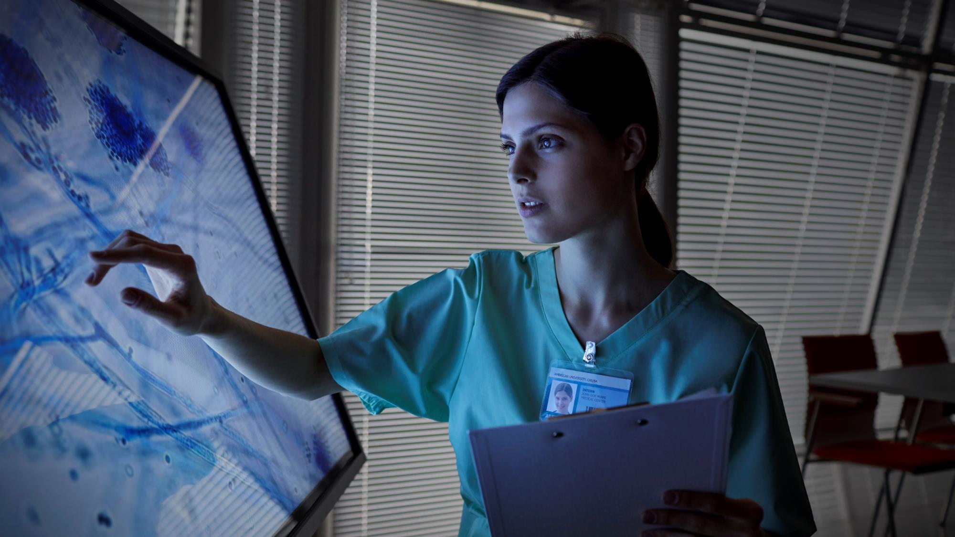
Twitter Vaccine NLP Analysis
By: The A-Team

Slide 2
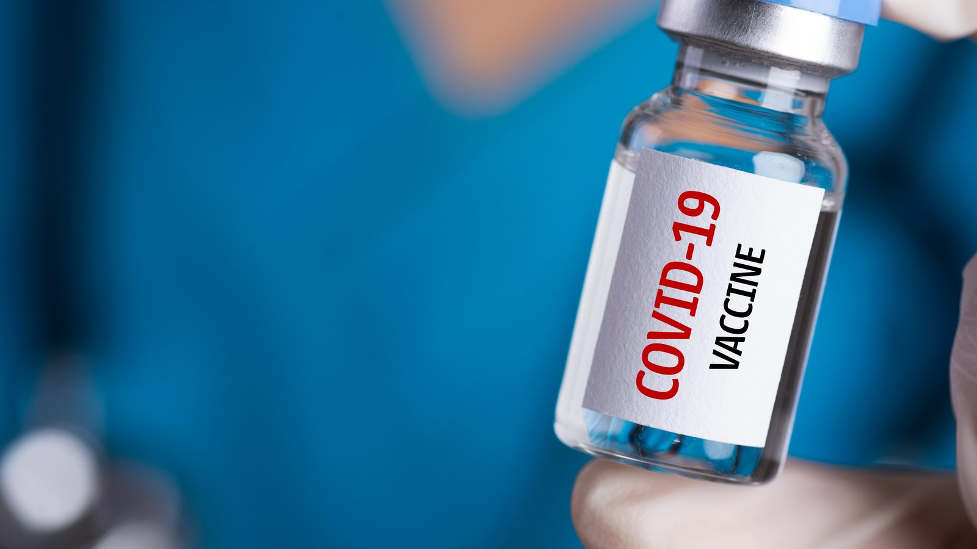

#covidvaccine
How can we leverage twitter to
optimize the perception of our vaccine?

Slide 3
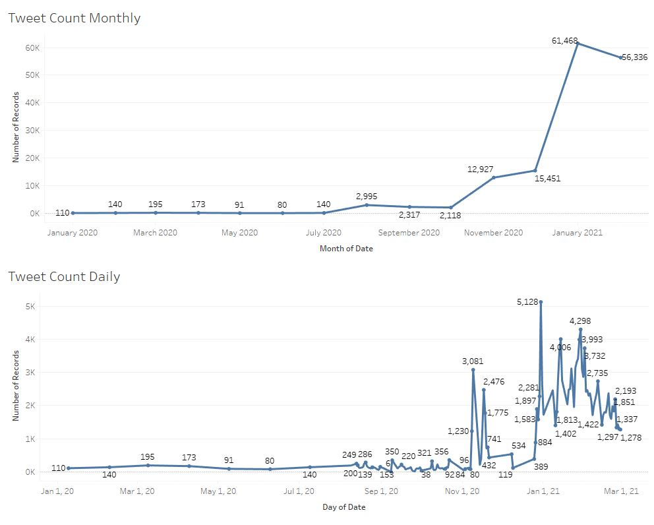

Slide 4
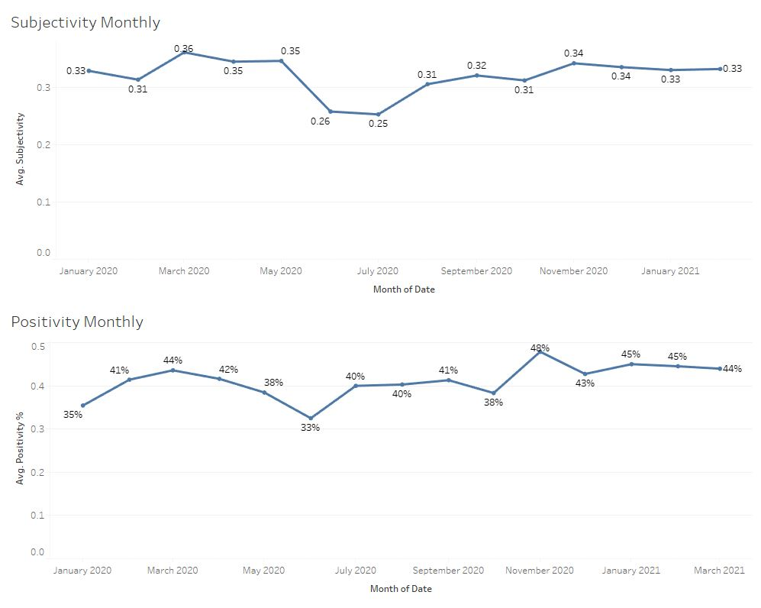

Slide 5
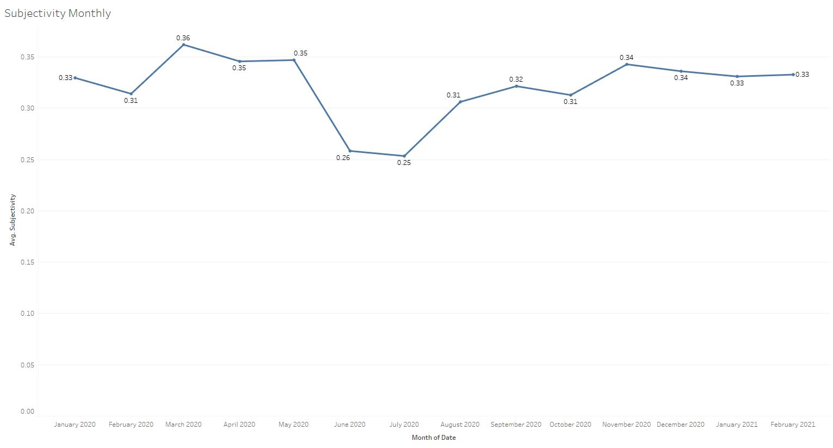

Slide 6
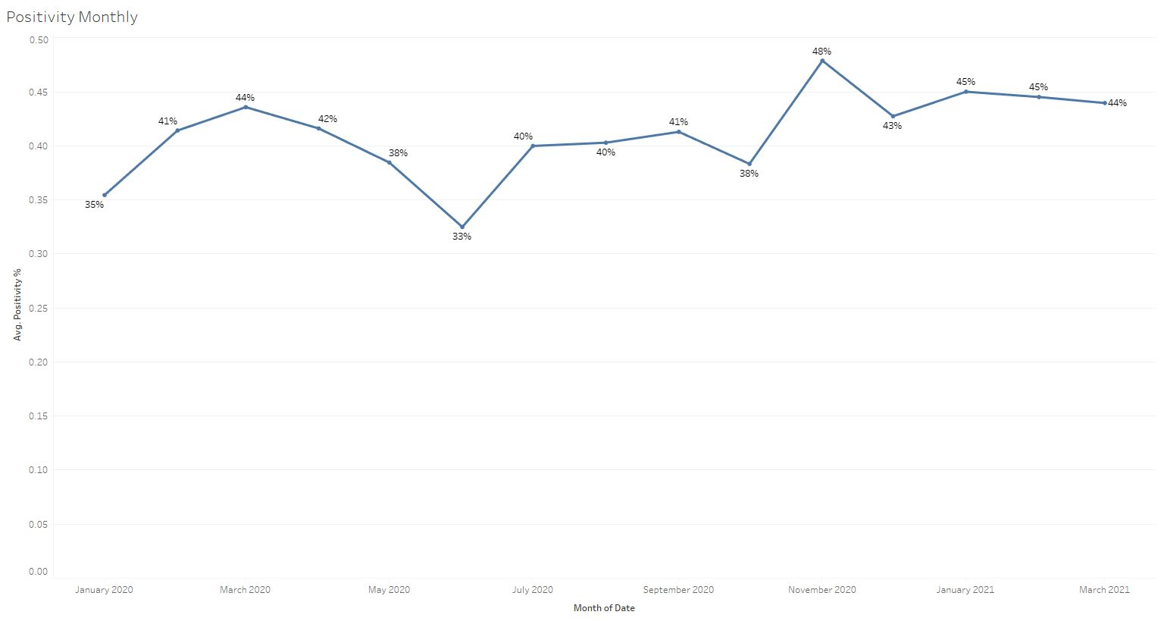

Slide 7
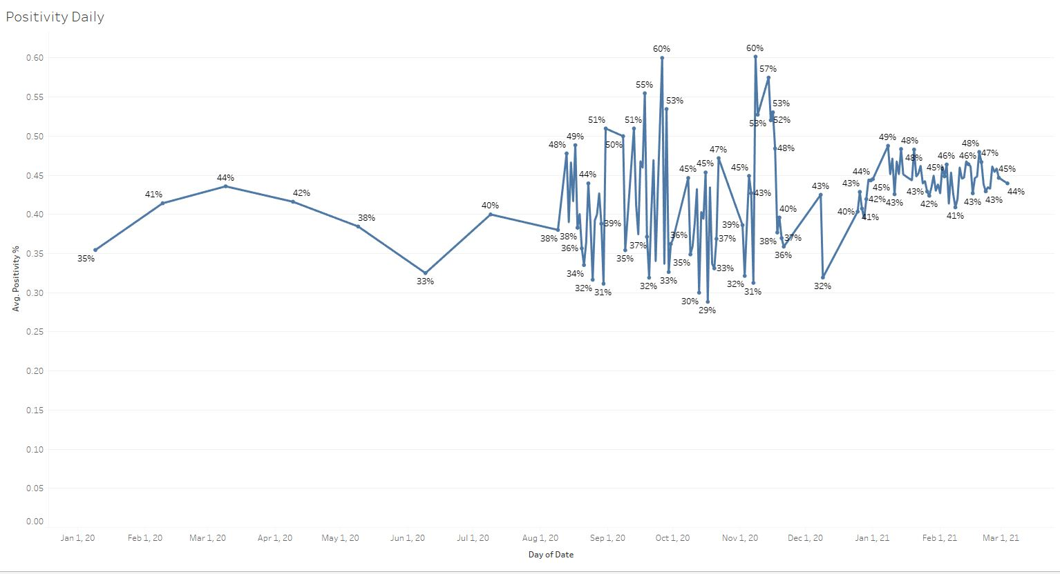

Slide 8
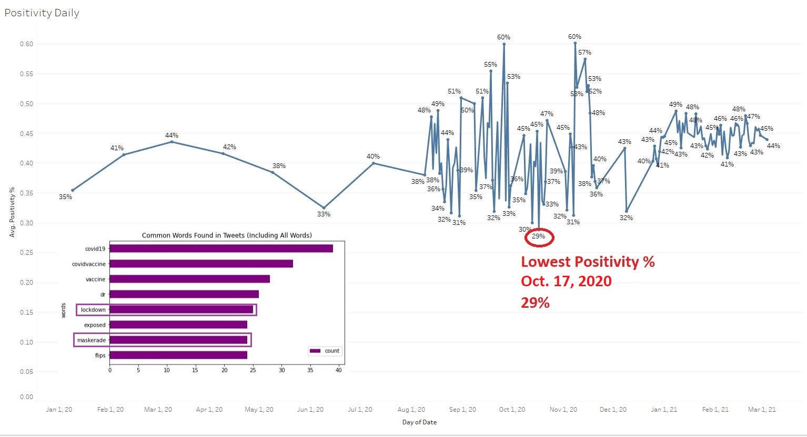

Slide 9
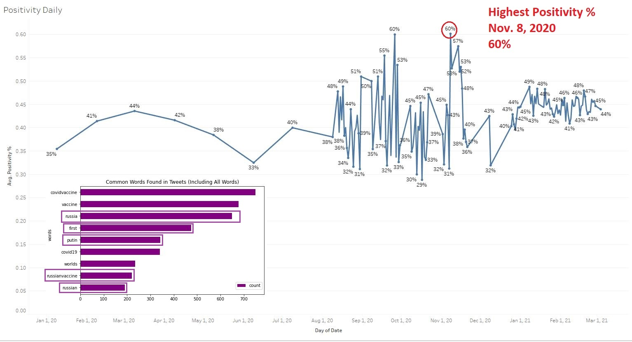

Slide 10
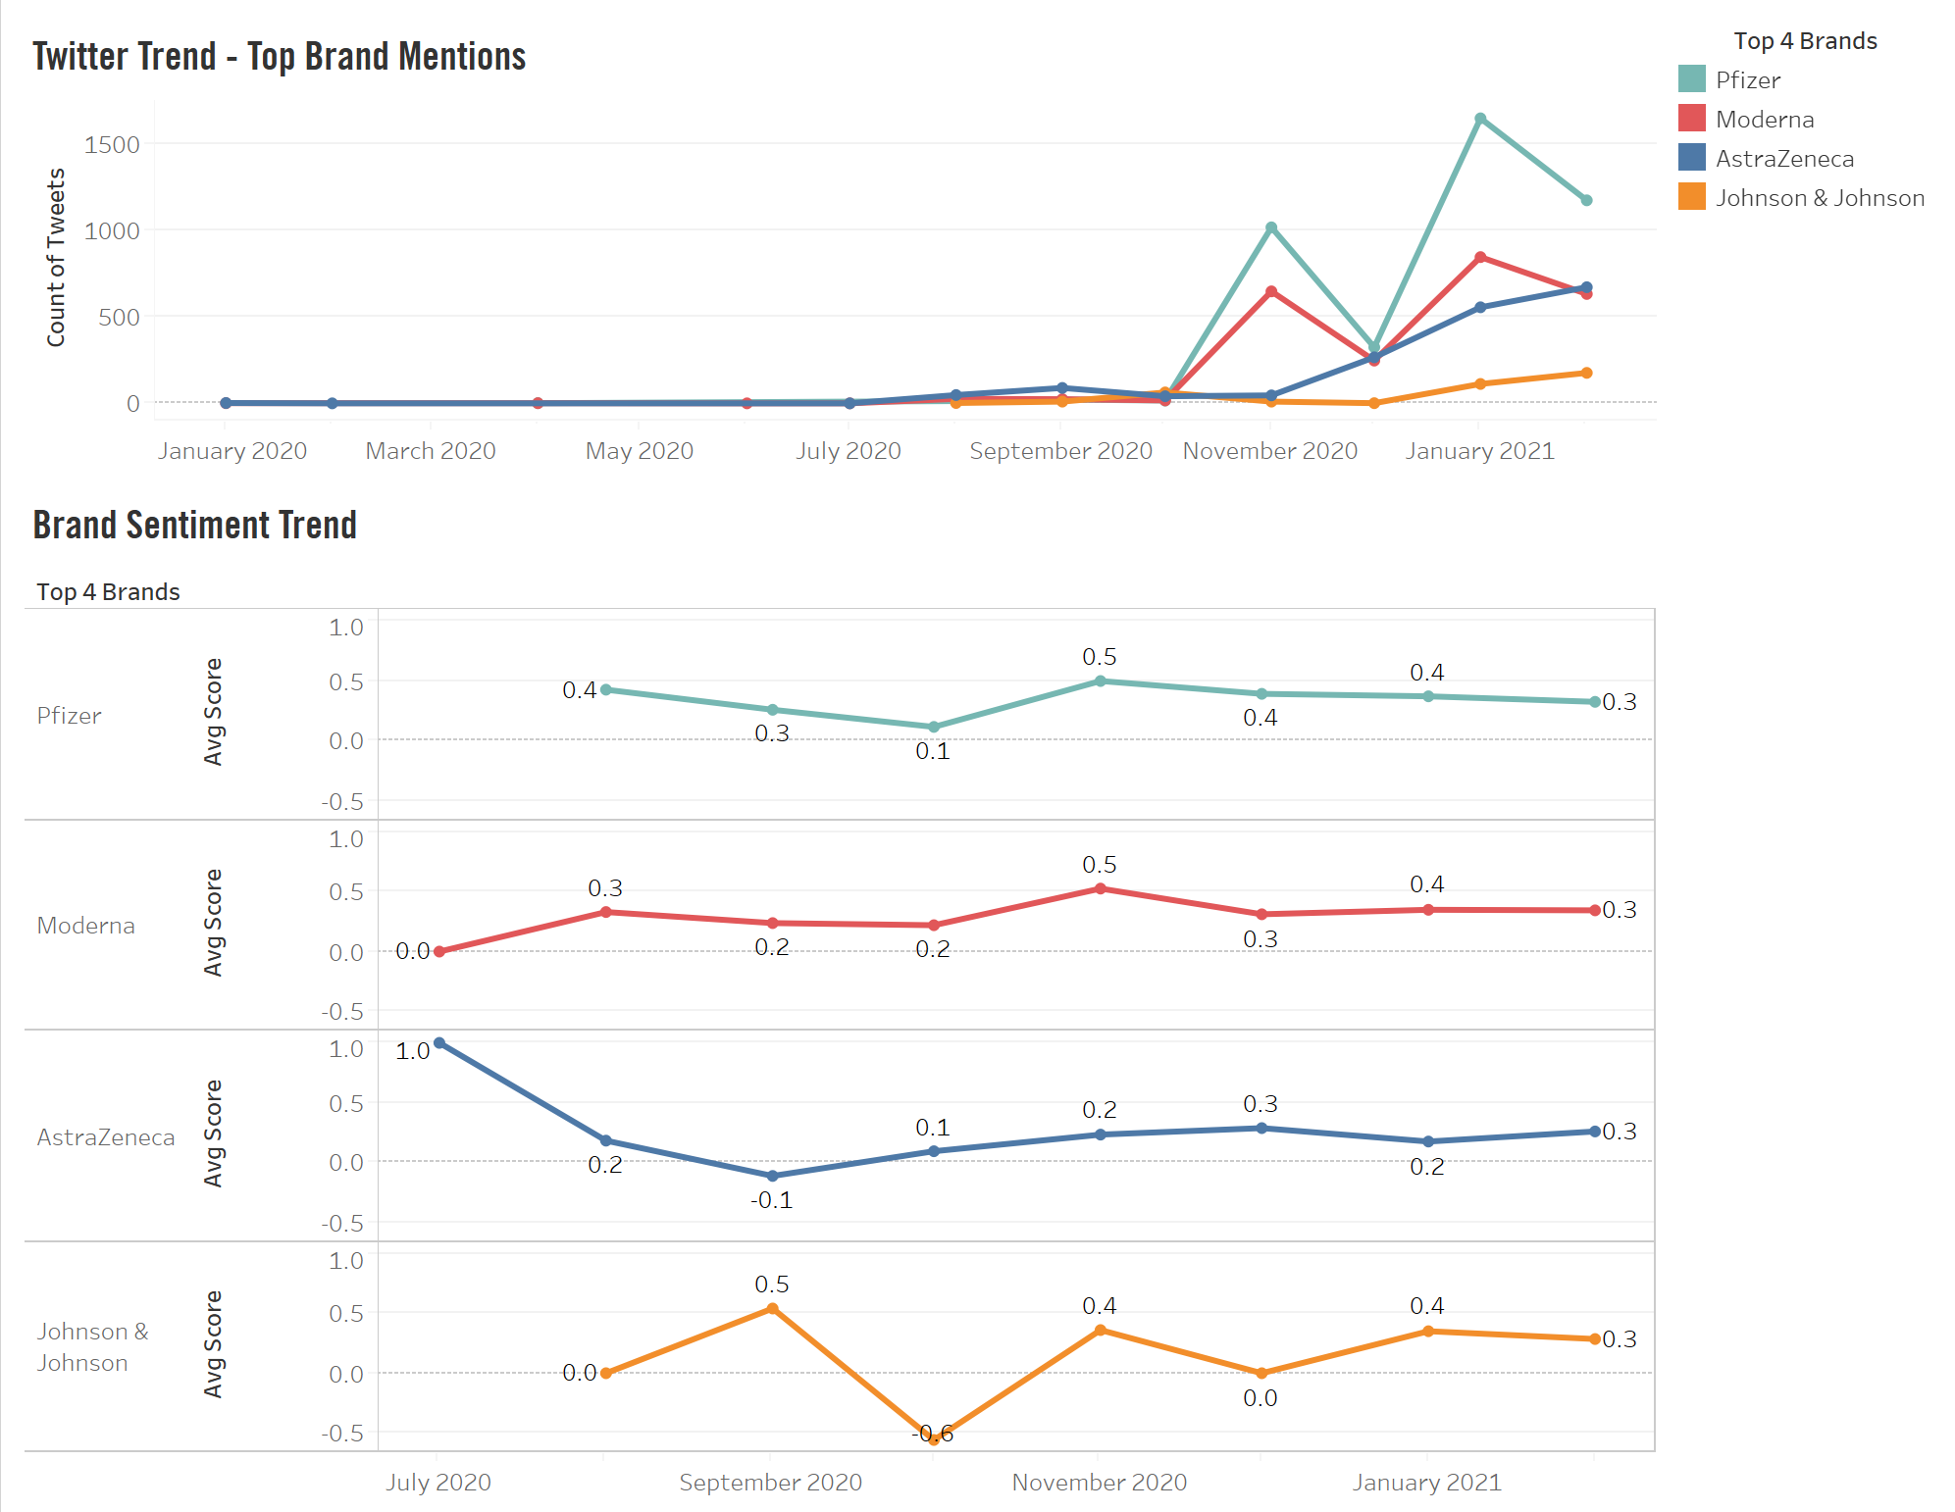
Positive
Neutral
Negative
Positive
Neutral
Negative
Positive
Neutral
Negative
Positive
Neutral
Negative

Slide 11
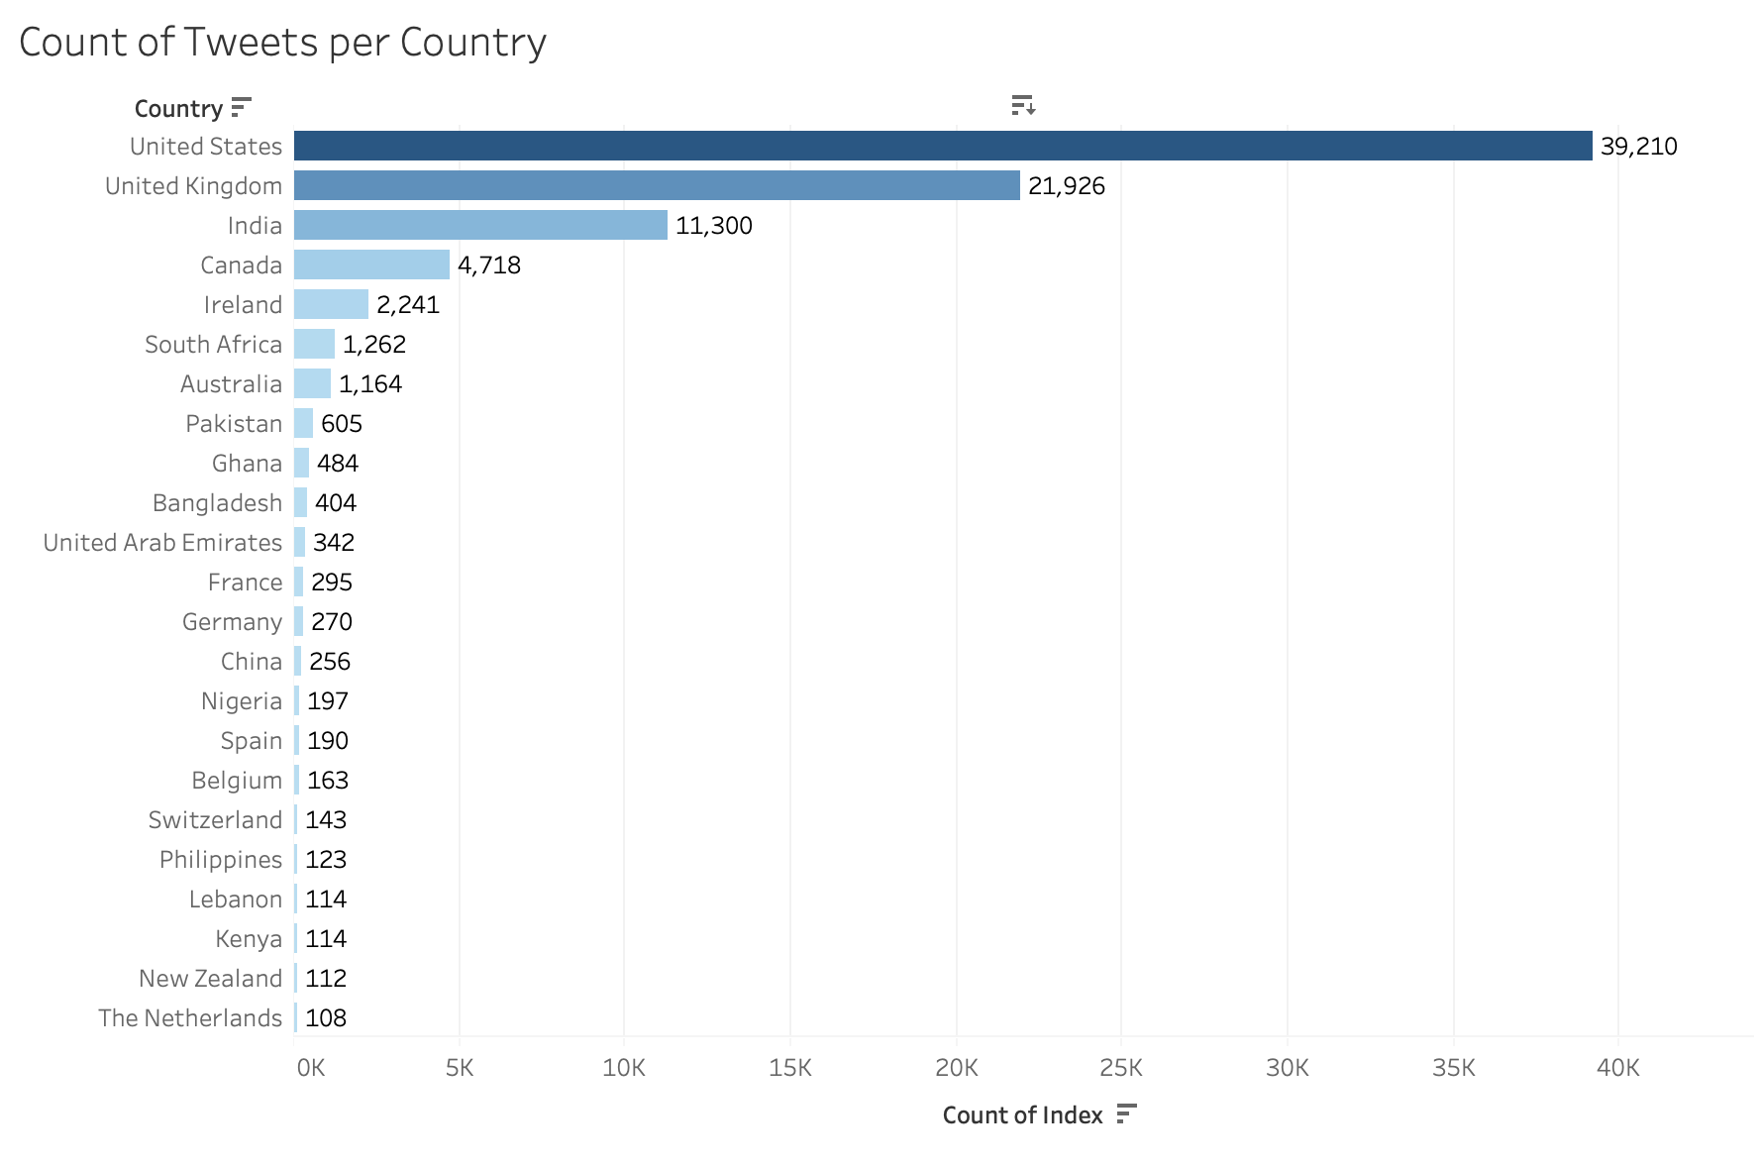

Slide 12
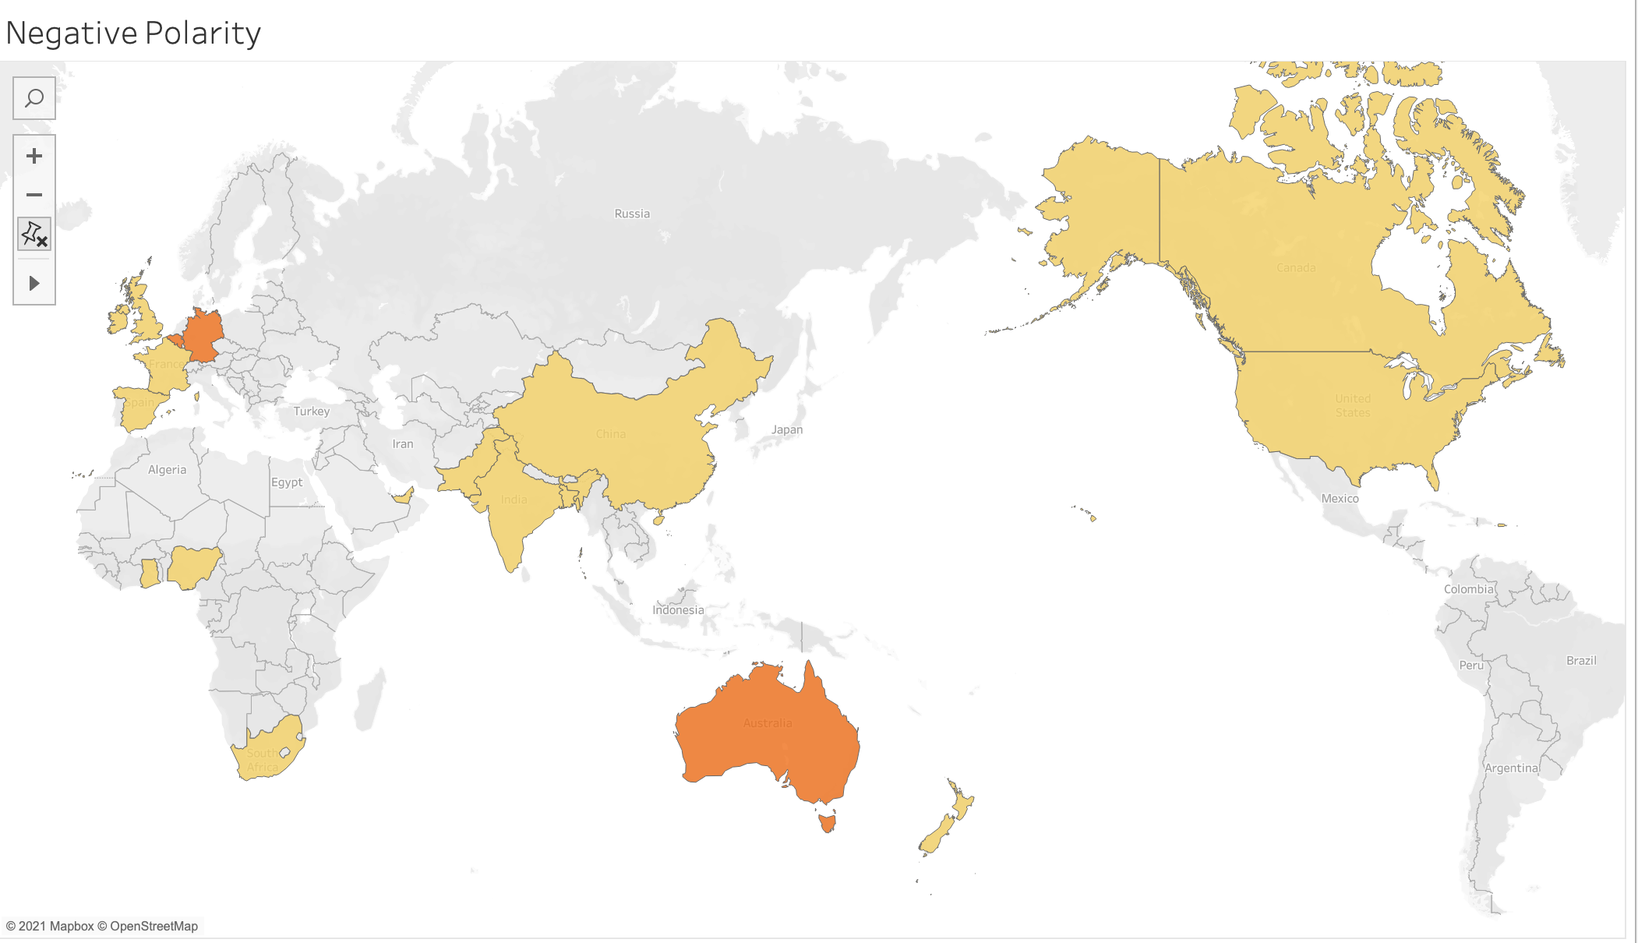
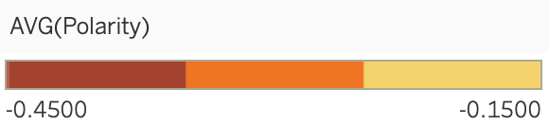

Slide 13
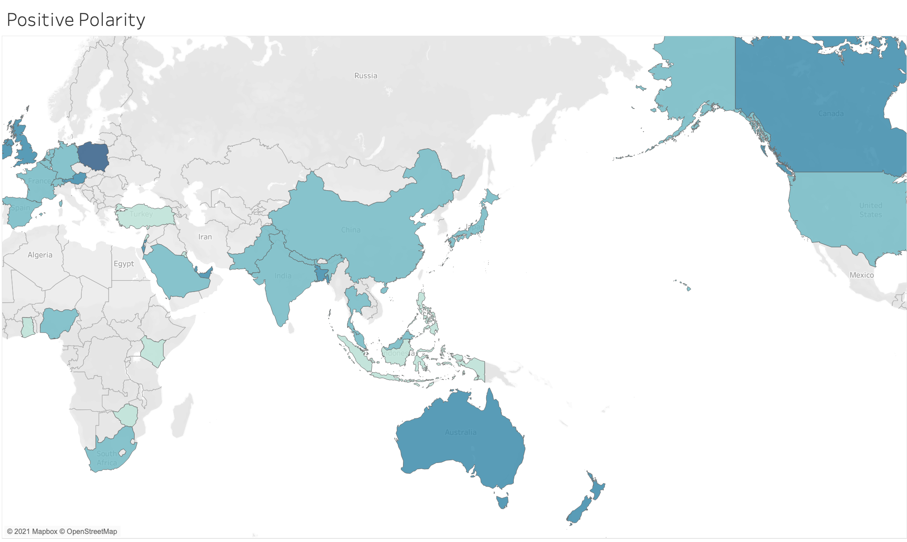
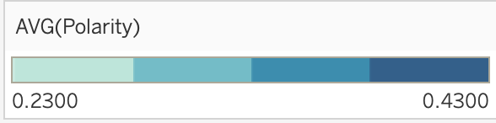

Slide 14
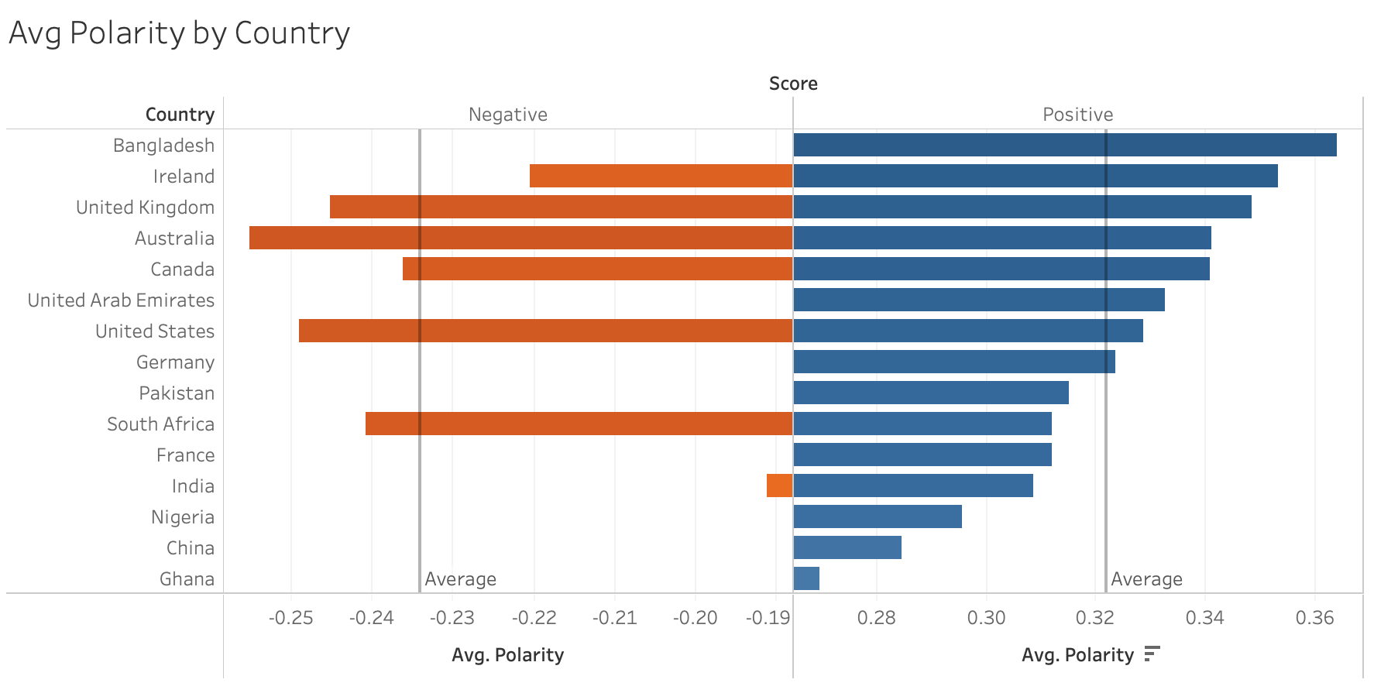

Slide 15
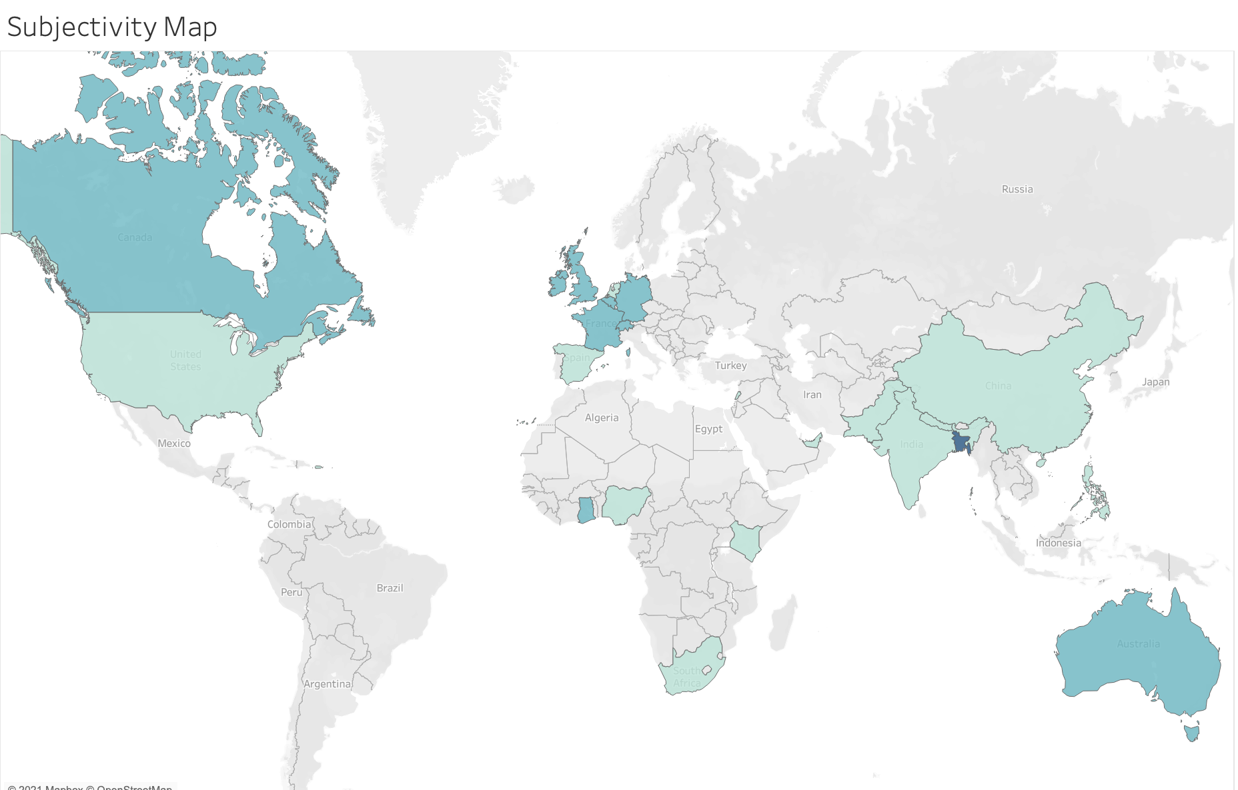
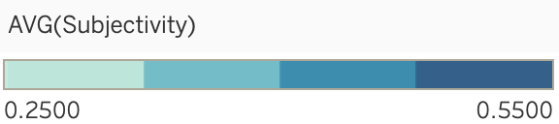

Slide 16
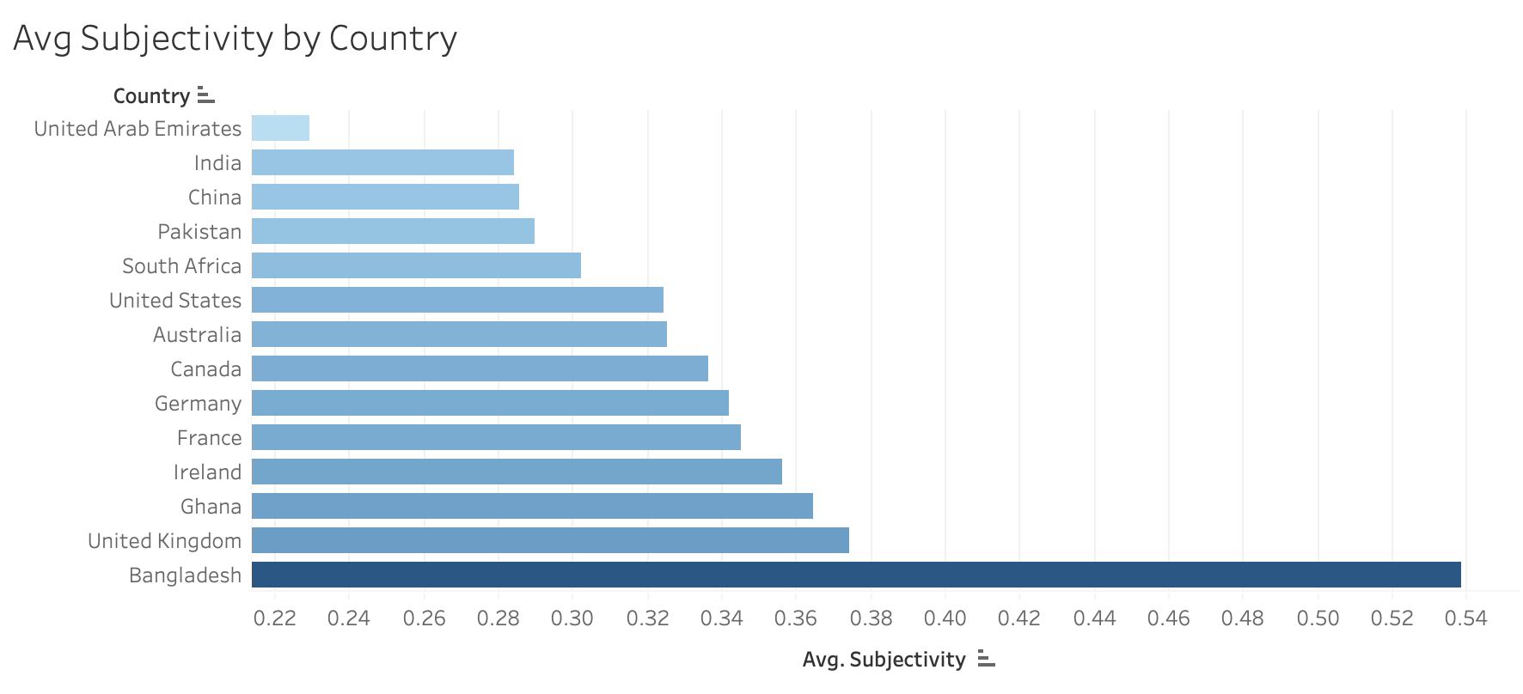

Slide 17
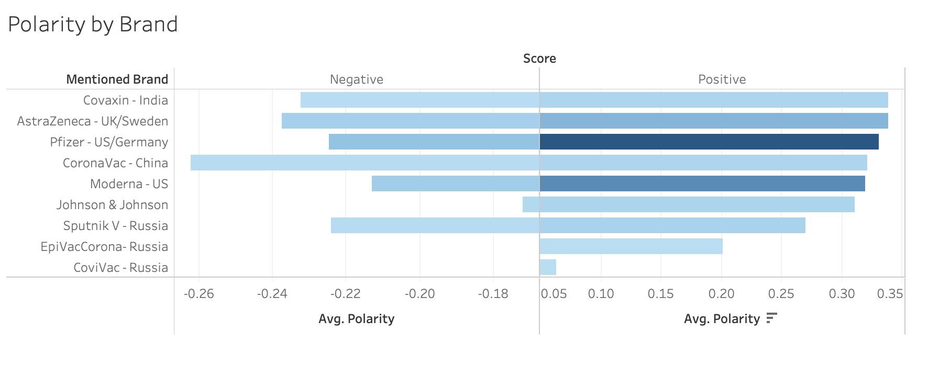

Slide 18


Slide 19
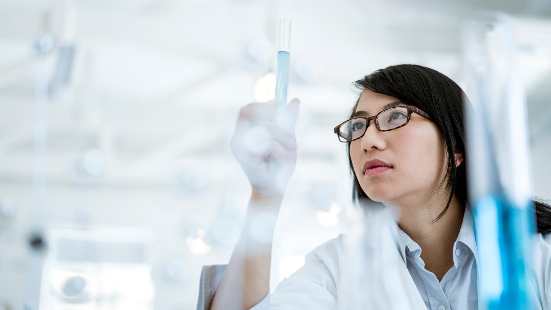
CONCLUSION
Over time, there is an increasing trend in positive sentiment
All big 4 vaccine manufacturers had ebbs and flows, but all have positive sentiments
Subjectivity varied widely globally
Sentiment was positive
Dichotomy of sentiment
People are anxious to return to life as we knew it

Slide 20
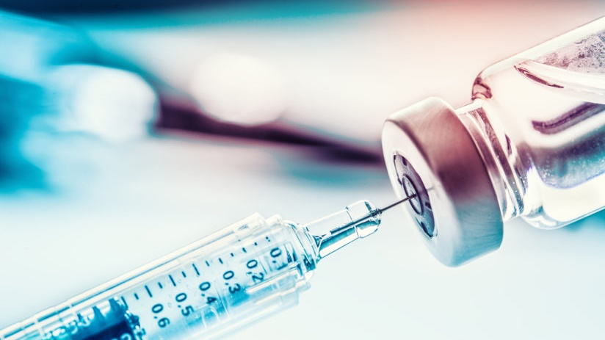
Thank You

